Slide 1
Installation
Anaconda - https://www.anaconda.com/download/
PyCharm - https://www.jetbrains.com/help/pycharm/install-and-set-up-pycharm.html
Sublime - https://www.sublimetext.com/3

Slide 2
Installing Anaconda on Ubuntu
Check your Python version (type python in your terminal, then quit())
Install the version from https://www.anaconda.com/download/
Go to the file location, chmod +x <file_name>
./<file_name>
Follow the instructions

Slide 3
Github Intro

Slide 4
Steps
Create a Github account
Create a repository from github web page
Download Git Bash OR use Anaconda Prompt
Clone the repository or create one from command line

Slide 5

Clone the existing repository

Slide 6
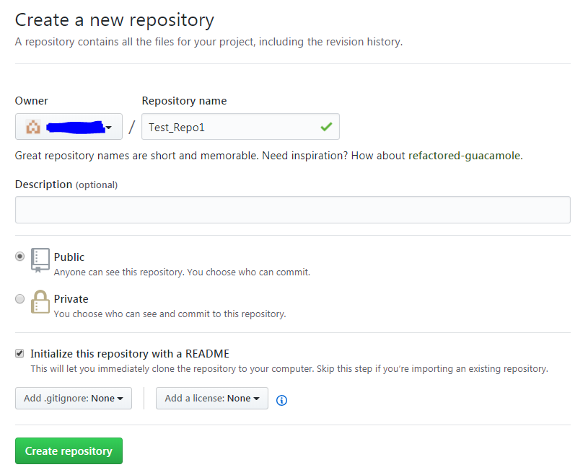

Slide 7
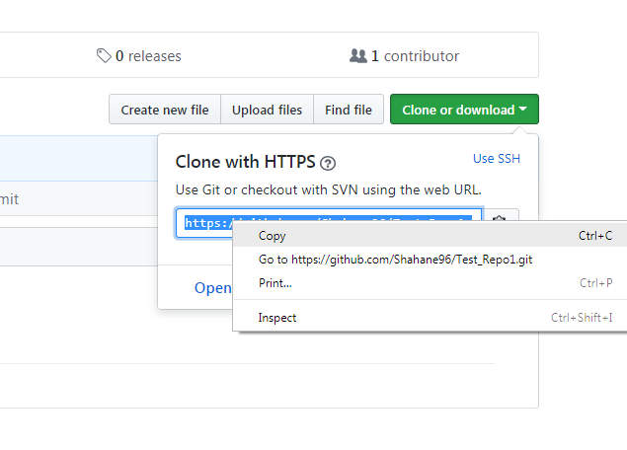

Slide 8
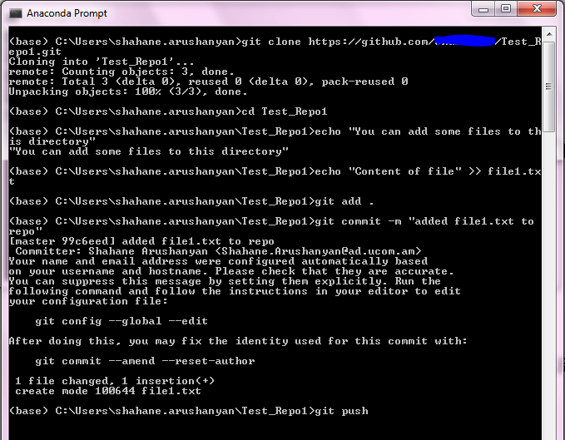

Slide 9
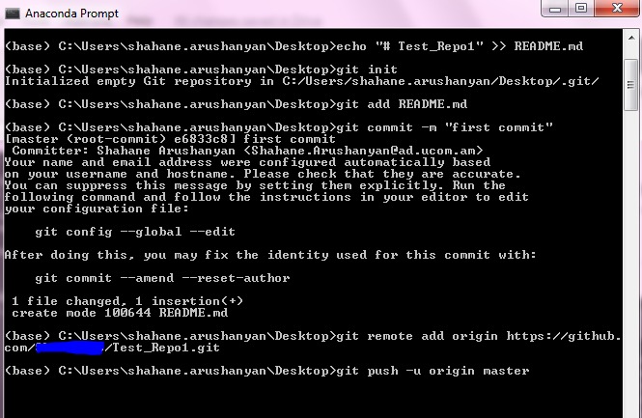
Create a repository from command line

Slide 10
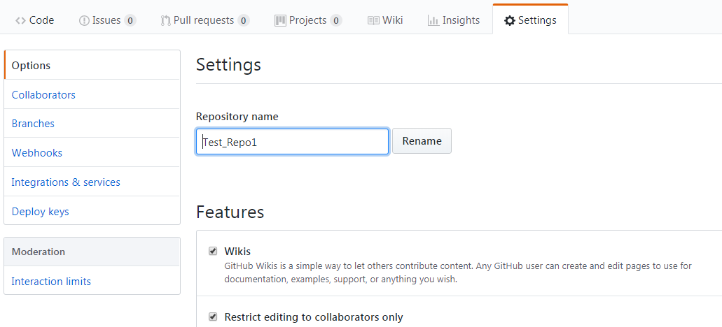
Deleting a repository from GitHub

Slide 11
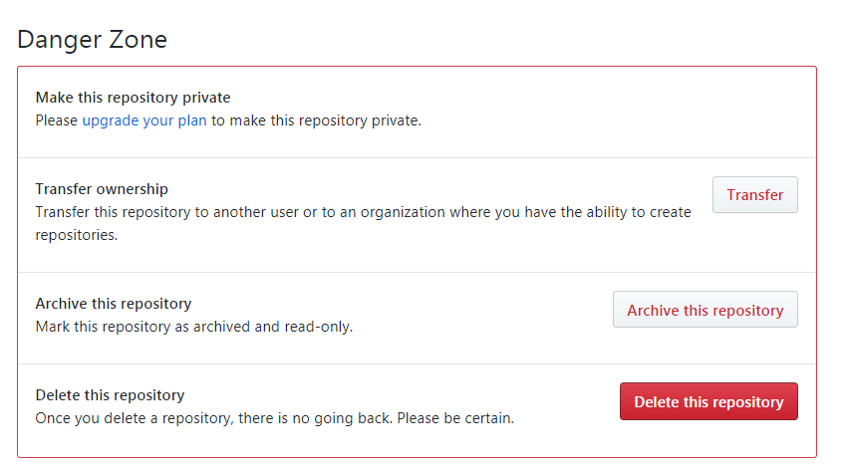

Slide 12
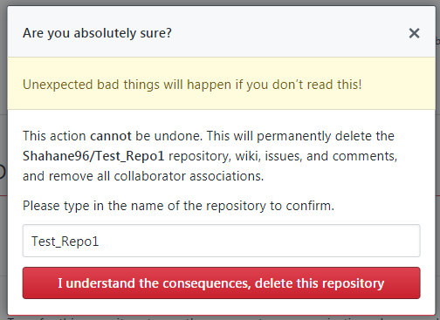

Slide 13
Evaluation
Knowledge Sharing (KS)
Github Performance (GP)
Activity in Classes and Slack (AC)
Homework Score (HS)

Slide 14
That’s it!

